Slide 1
Data Analysis using NumPy
By Aksadur Rahman
aksadur@yahoo.com

Slide 2


Slide 3


Slide 4
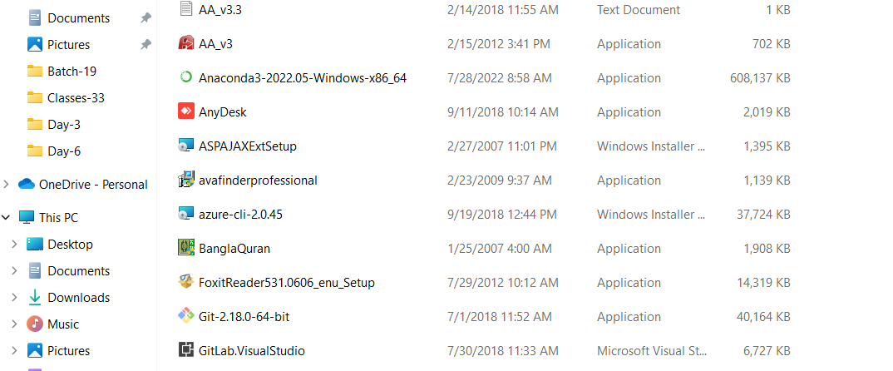

Slide 5
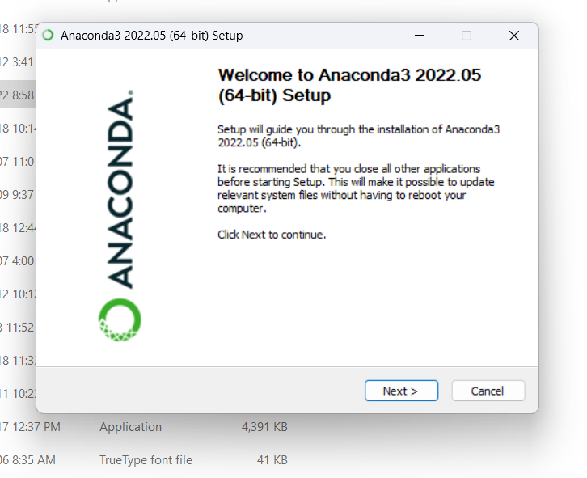

Slide 6
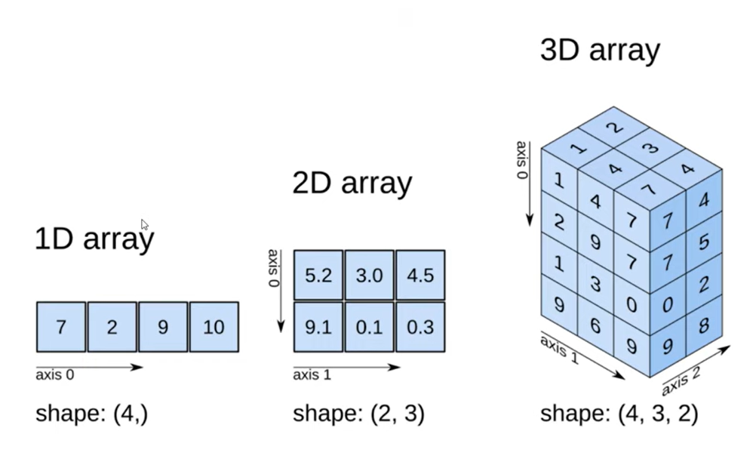
Numpy Array

Slide 7
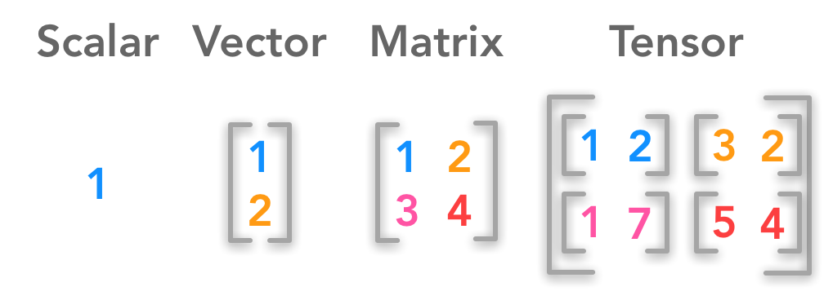
Numpy Array

Slide 8
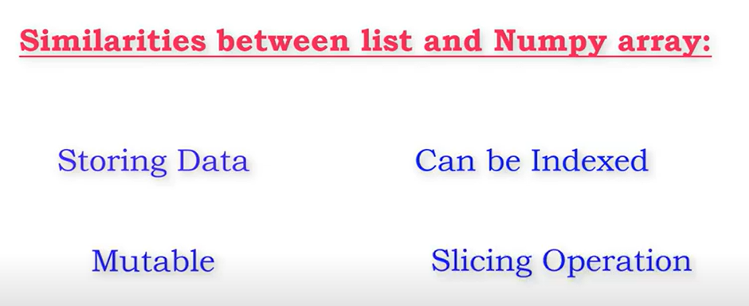
List vs Numpy Array

Slide 9
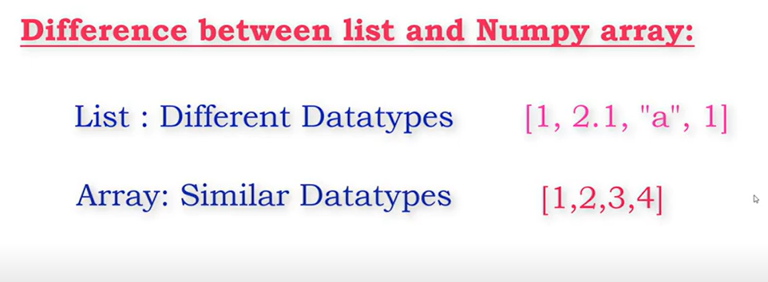

List vs Numpy Array

Slide 10
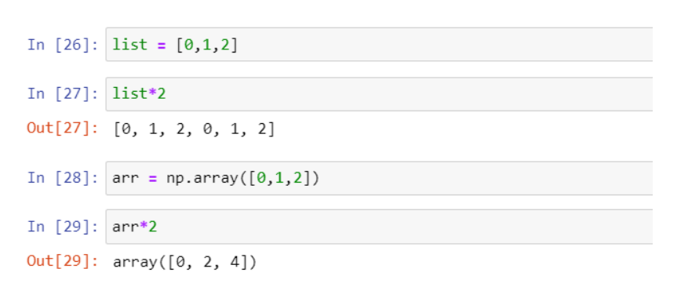
List vs Numpy Array
A list cannot directly handle a mathematical operations, while array can

Slide 11
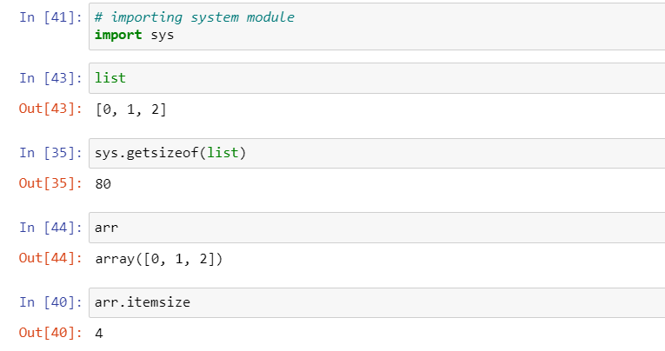
List vs Numpy Array
An array consumes less memory than a list
Using an array is faster than a list
A list is easier to modify

